Slide 1




INDUSTRY 4.0 CELL
INSTITUTE OF AUTOMATION AND COMPUTER SCIENCE

Slide 2


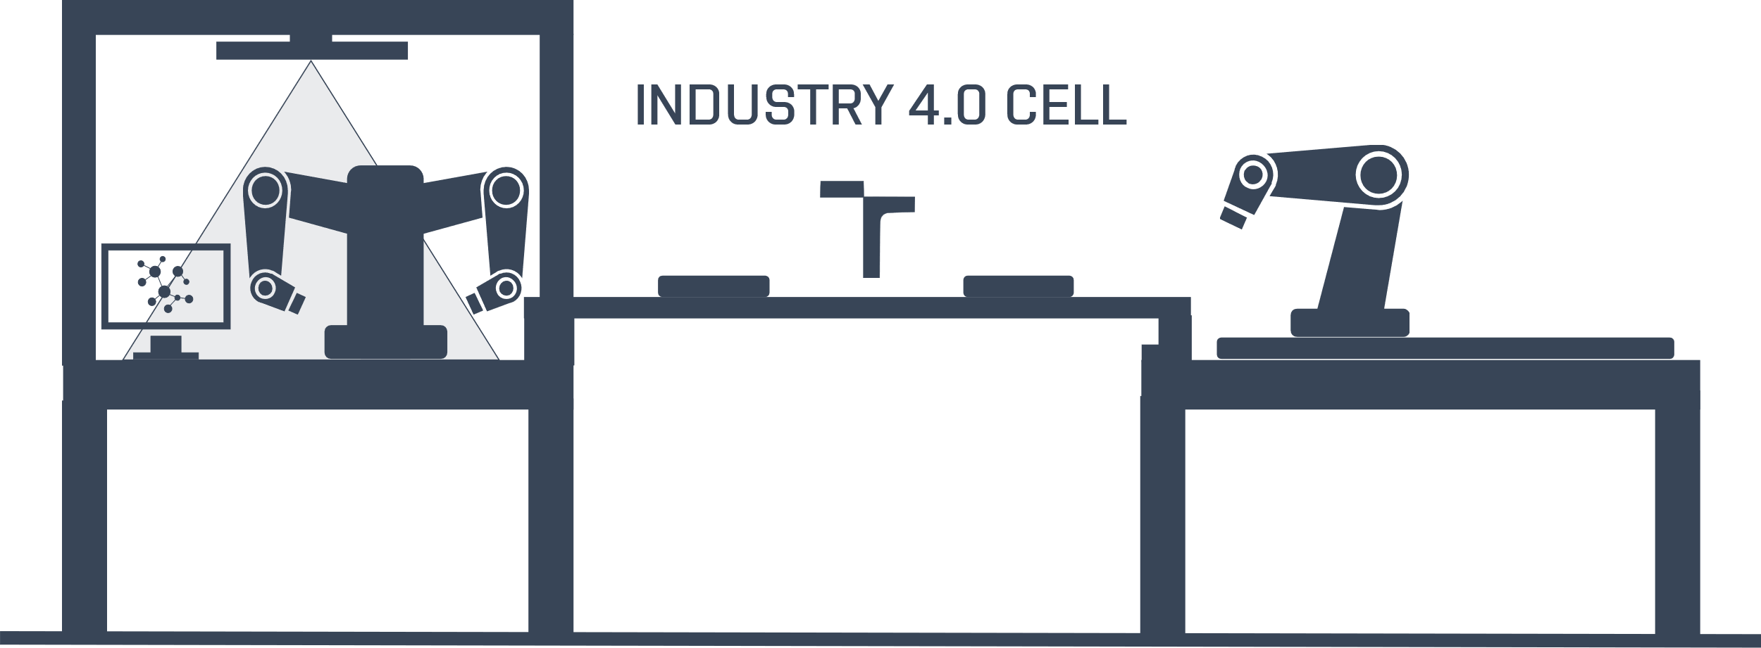

El Bestos Muchachos Teamos: Automated Medical Laboratory
Čermák, Jozefovič, Jukić
Brno, 2023
Brno, 2022

Slide 3


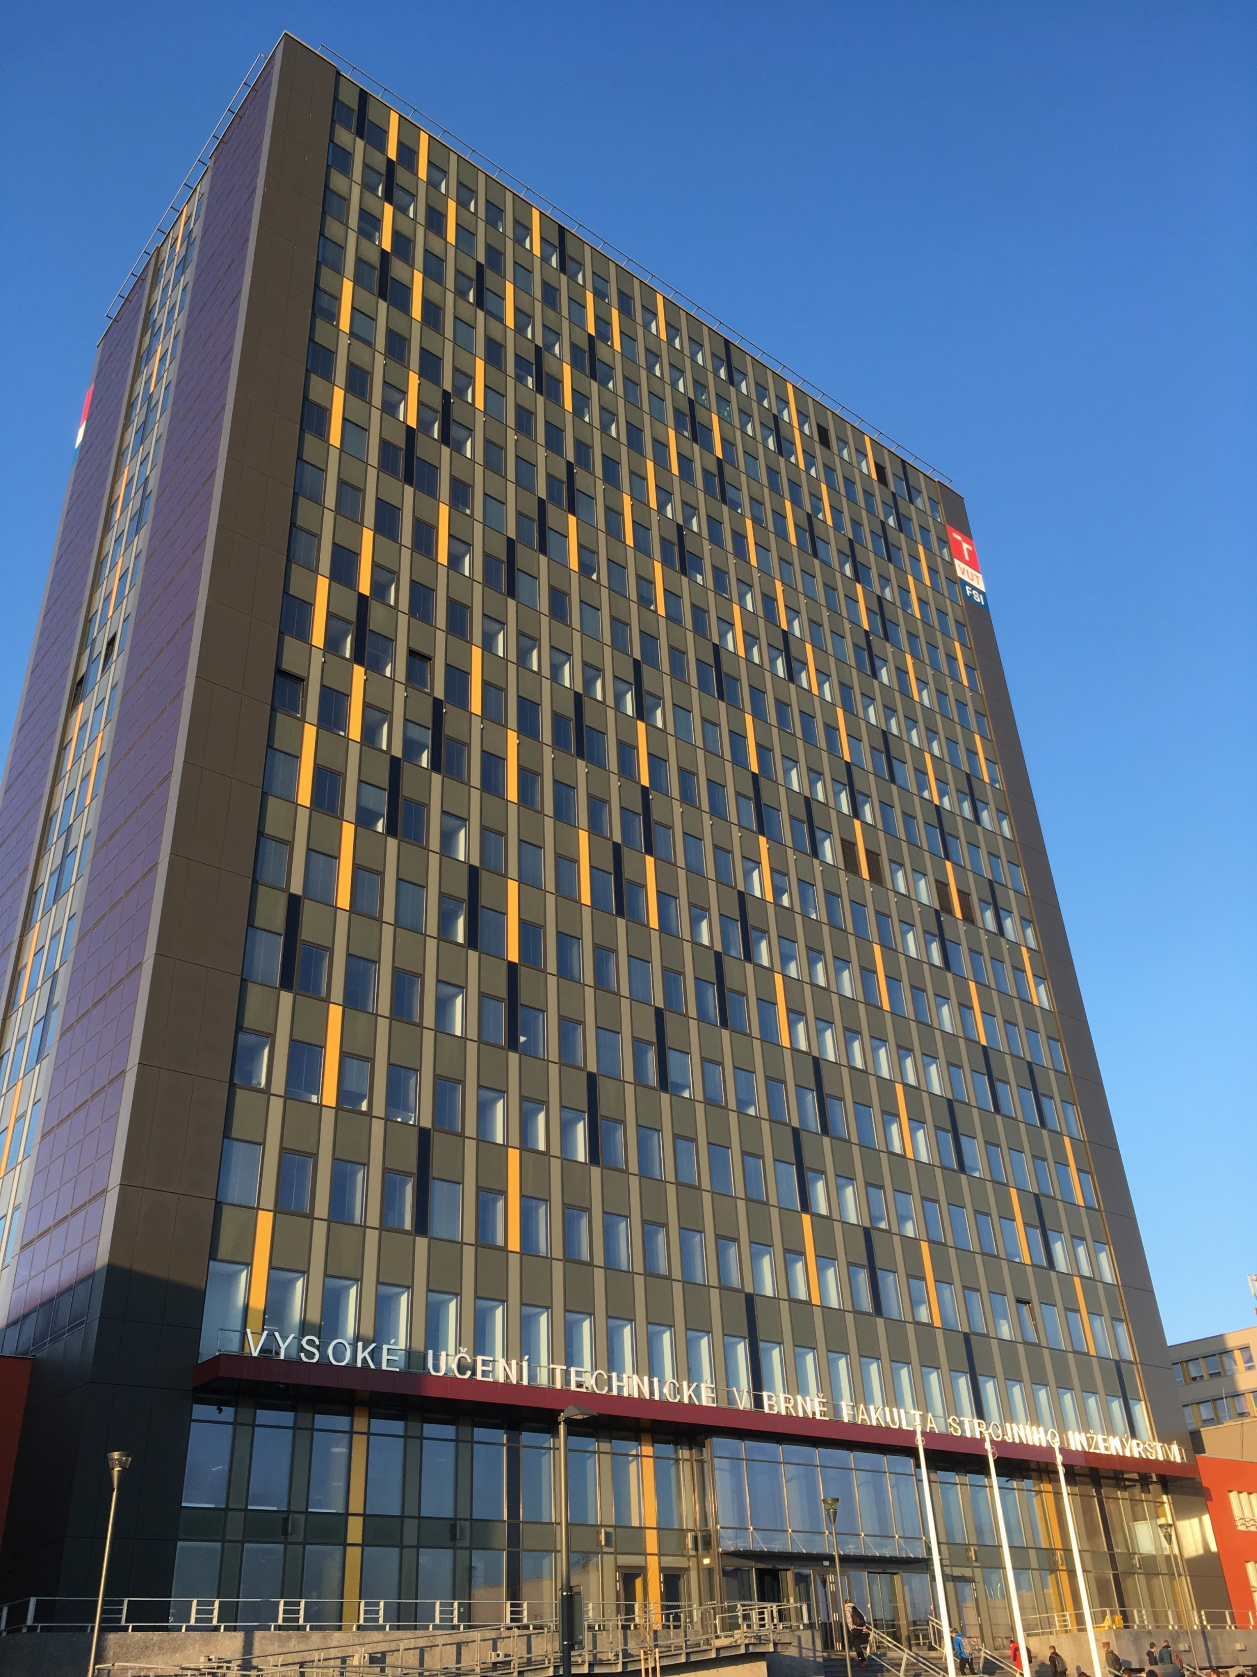
Content
1.
Definition of the Problem, Related Work, etc.
2.
Development Tools, Methods, etc.
3.
Design and Implementation of a Functional Solution
4.
Experiments and Results
5.
Conclusion and Future Work
© El Bestos Muchachos Teamos
2023 | Page 3/29
Content

Slide 4
Definition of the Problem

Slide 5
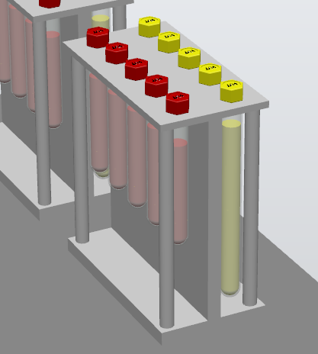
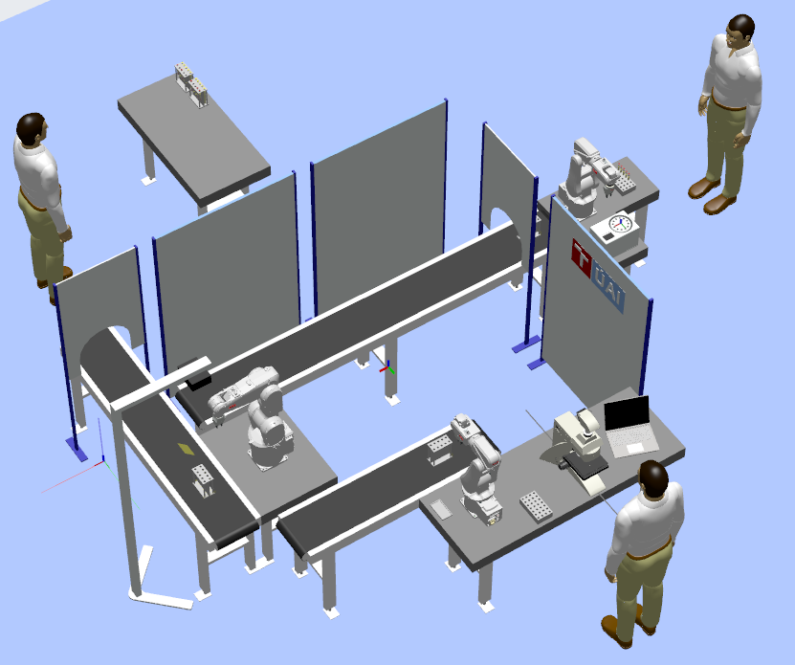
Definition of the Problem: Summary
Our project is about sorting and dealing with test tubes
Blood and urine
Different operation, different goals
→ Automated Medical Laboratory
© El Bestos Muchachos Teamos
2023 | Page 5/29
Definition of the Problem: Summary

Slide 6
Definition of the Problem: Summary
© El Bestos Muchachos Teamos
2023 | Page 6/29
Definition of the Problem: Summary

Slide 7
Development Tools and Methods

Slide 8

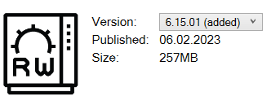
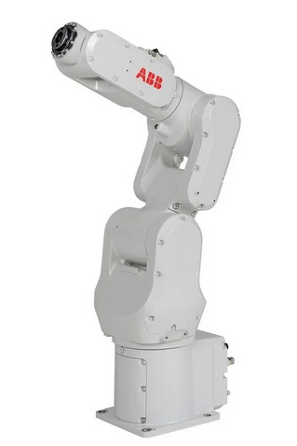
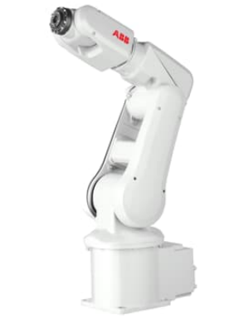
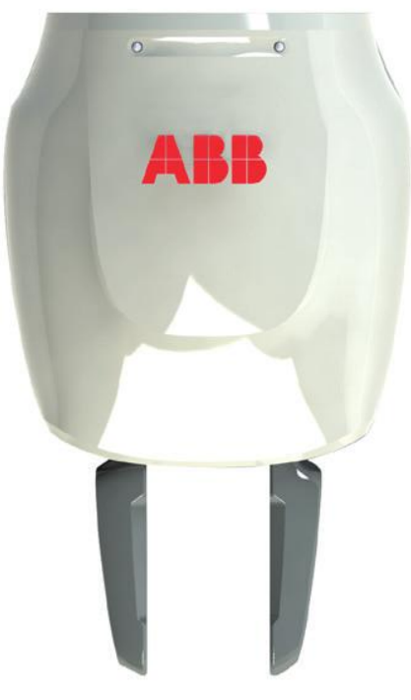
Development Tools and Methods: Robot Studio
Robot Studio
RobotWare 6.15.01
2x Robot IRB 120, 1x Robot IRB 1200
3x ABB Smart Gripper
© El Bestos Muchachos Teamos
2023 | Page 8/29
Development Tools and Methods: Robot Studio

Slide 9
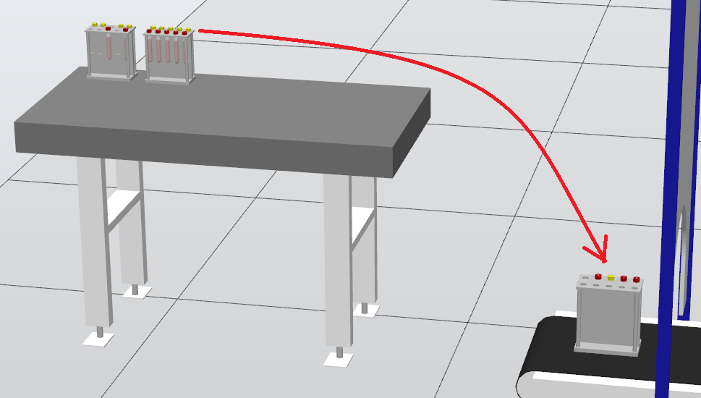
Development Tools and Methods: Random Generator
Random Generator
Random test tubes are inserted onto the conveyor
© El Bestos Muchachos Teamos
2023 | Page 9/29
Development Tools and Methods: Random Generator

Slide 10
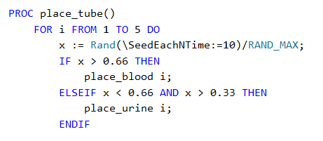
Development Tools and Methods: Random Generator
Random Generator
Rapid script
© El Bestos Muchachos Teamos
2023 | Page 10/29
Development Tools and Methods: Random Generator

Slide 11
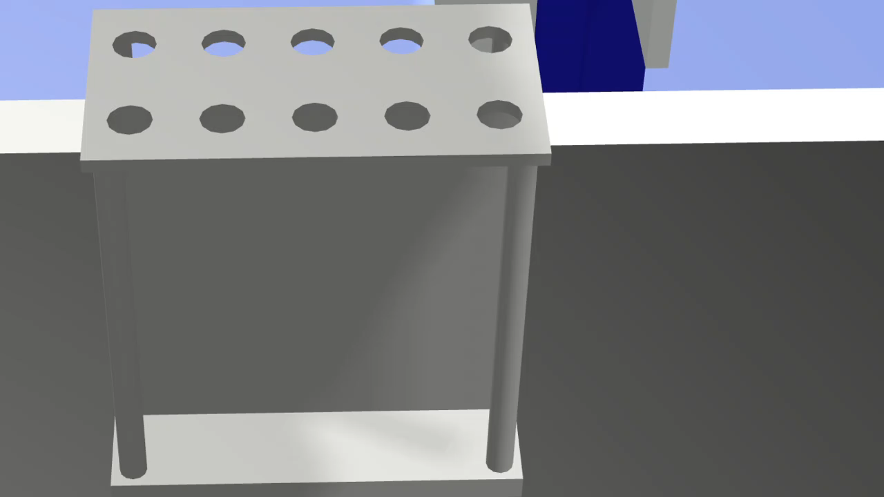
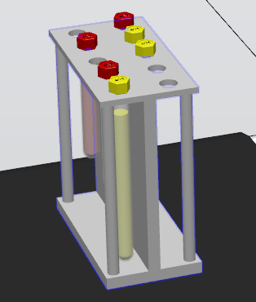
Development Tools and Methods: Random Generator
Random Generator
Result
© El Bestos Muchachos Teamos
2023 | Page 11/29
Development Tools and Methods: Random Generator

Slide 12
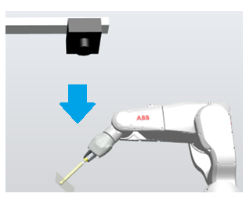
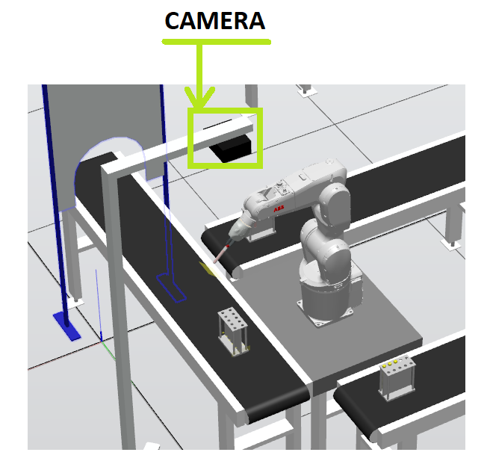
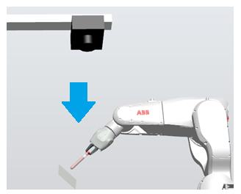
Development Tools and Methods: Camera Scanning
Camera Scanning Simulation
© El Bestos Muchachos Teamos
2023 | Page 12/29
Development Tools and Methods: Camera Scanning

Slide 13
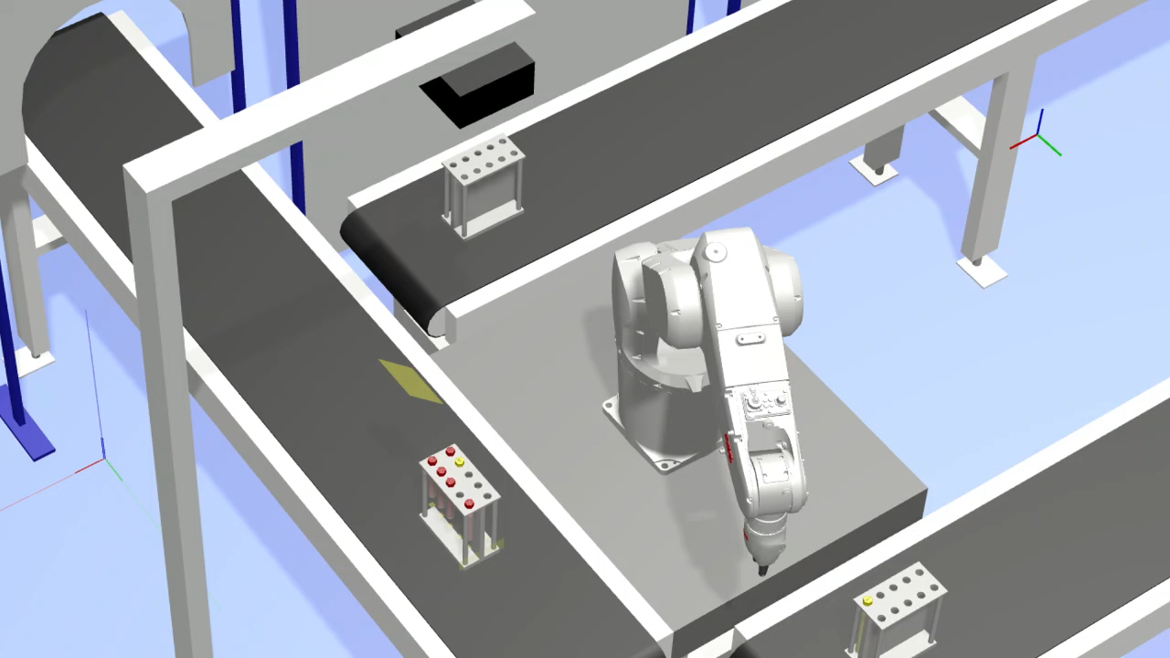
Development Tools and Methods: Camera Scanning
Camera Scanning Simulation
© El Bestos Muchachos Teamos
2023 | Page 13/29
Development Tools and Methods: Camera Scanning

Slide 14
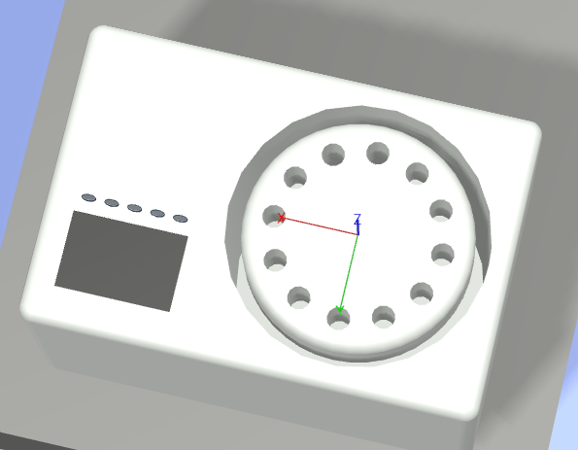
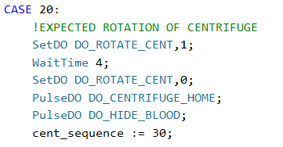
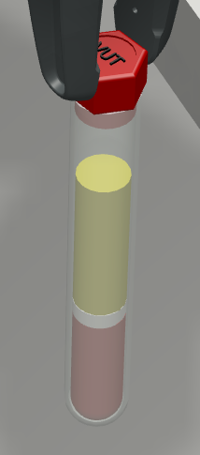
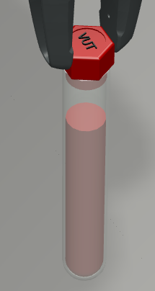
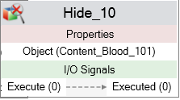
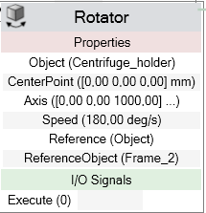
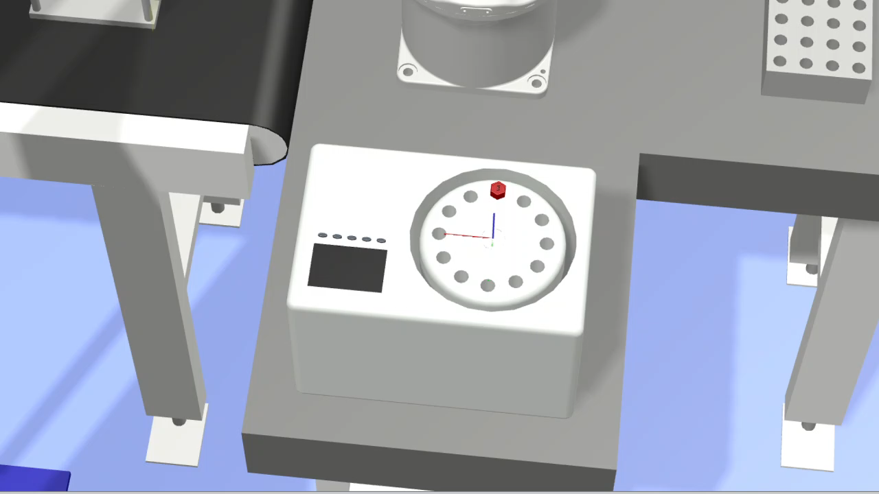
Development Tools and Methods: Centrifuge
Centrifuge blood separation
Red Blood Cells
White Blood Cells
Blood Plasma
© El Bestos Muchachos Teamos
2023 | Page 14/29
Development Tools and Methods: Centrifuge

Slide 15
Design and Implementation of Functional Solution

Slide 16
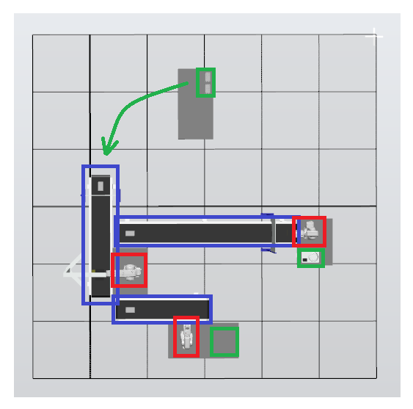


Design and Implementation of Functional Solution
Blue … Conveyors
Red … Robots
Green … Centrifuge, Microscop
and starting Base-point
© El Bestos Muchachos Teamos
2023 | Page 16/29
Design and Implementation of Functional Solution

Slide 17
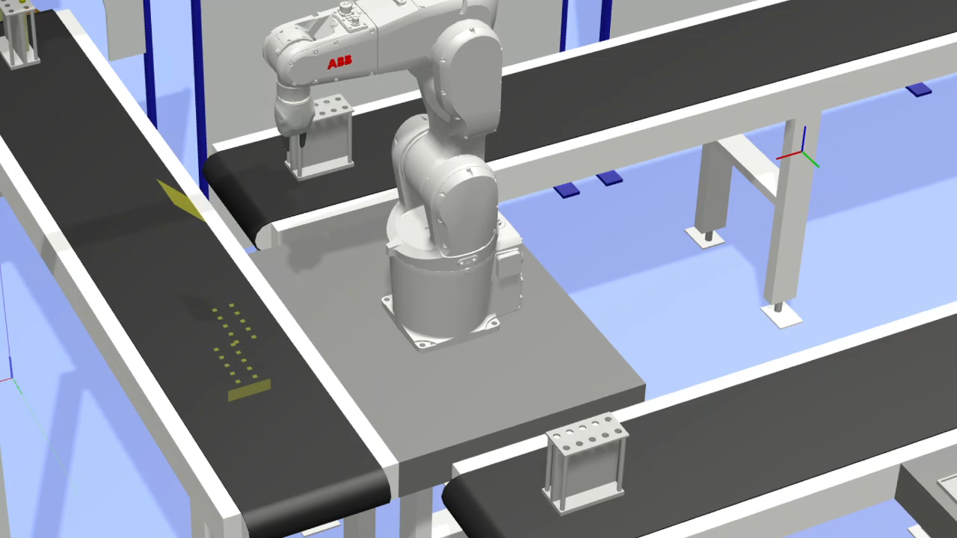
Design and Implementation of Functional Solution
Camera
© El Bestos Muchachos Teamos
2023 | Page 17/29
Design and Implementation of Functional Solution

Slide 18
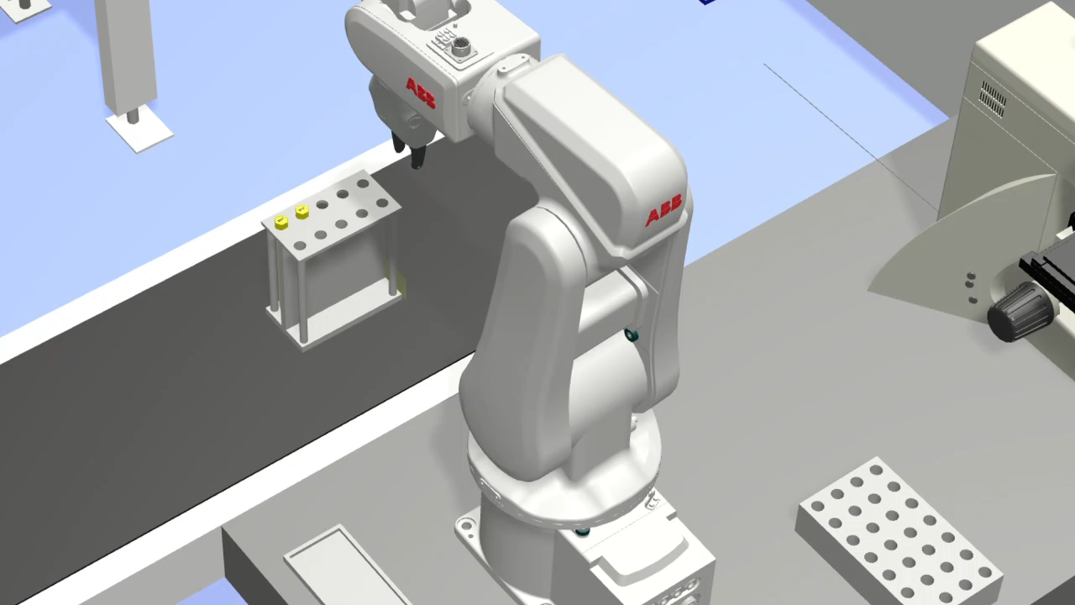
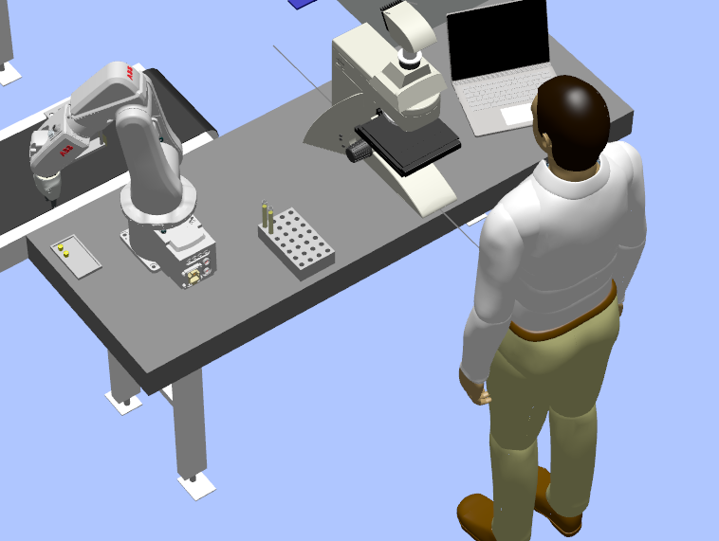
Design and Implementation of Functional Solution
Microscop
© El Bestos Muchachos Teamos
2023 | Page 18/29
Design and Implementation of Functional Solution

Slide 19
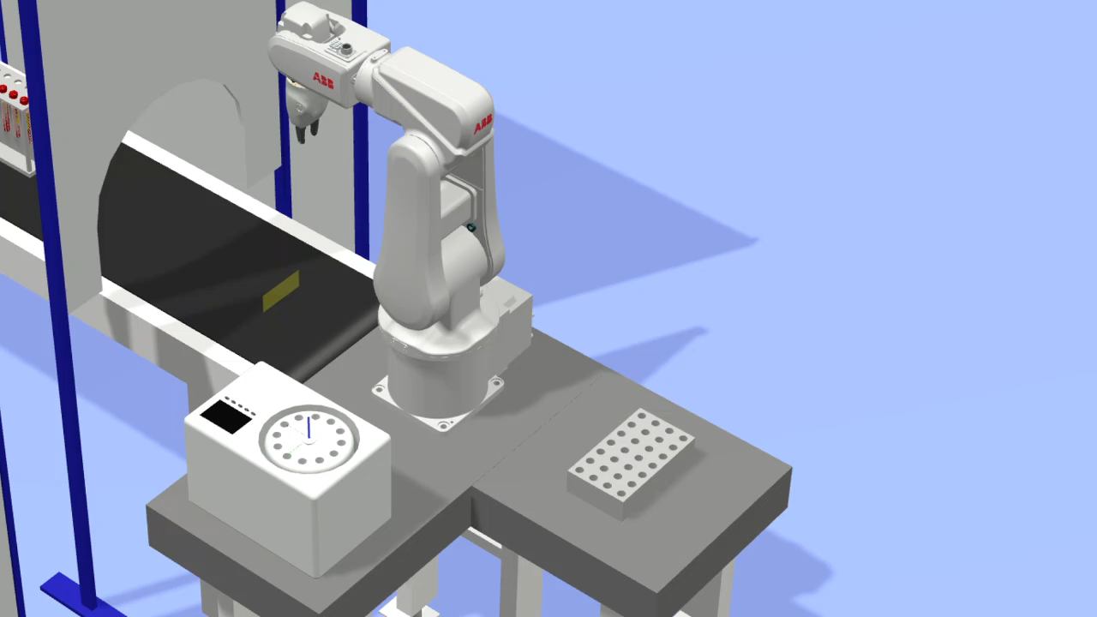
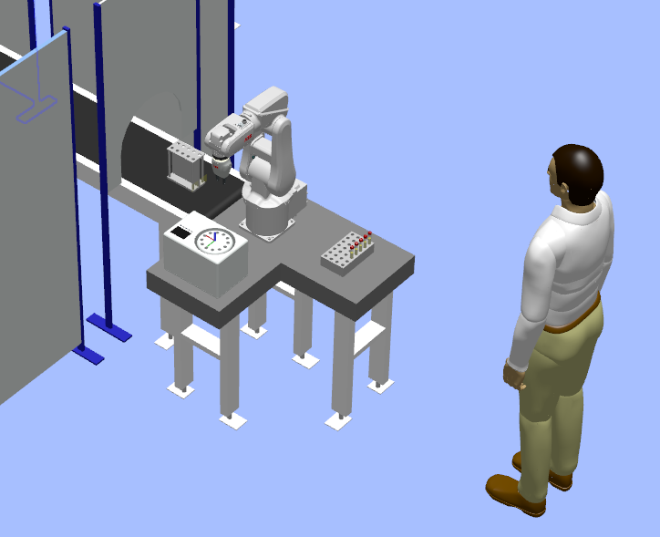
Design and Implementation of Functional Solution
Centrifuge
© El Bestos Muchachos Teamos
2023 | Page 19/29
Design and Implementation of Functional Solution

Slide 20
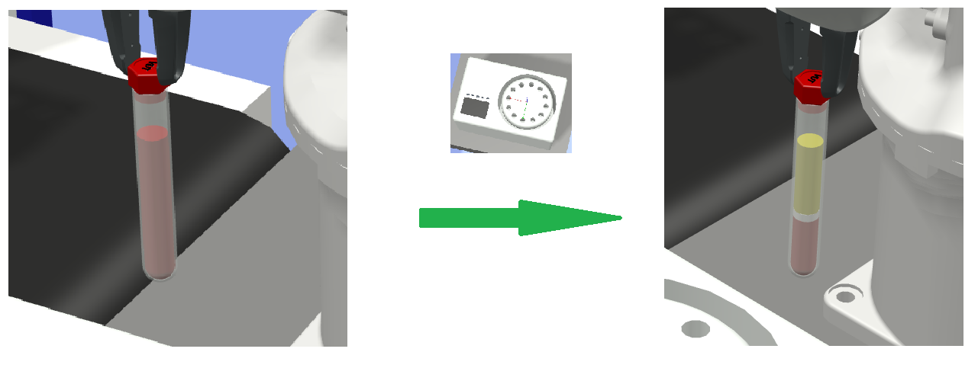
Design and Implementation of Functional Solution
© El Bestos Muchachos Teamos
2023 | Page 20/29
Design and Implementation of Functional Solution

Slide 21
Experiments and Results

Slide 22
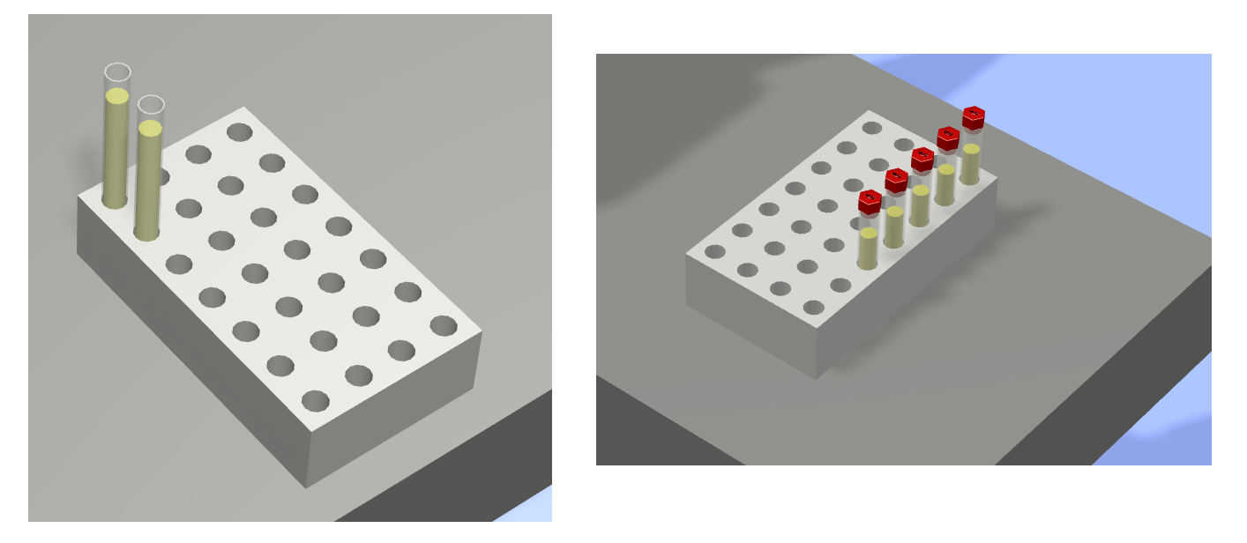

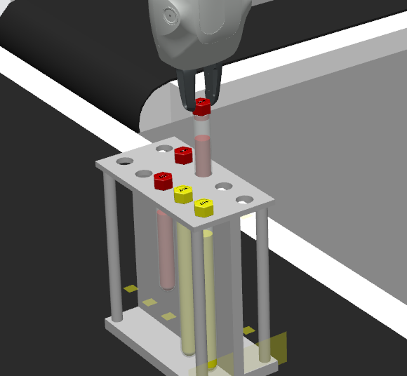
Experiments and Results: Does It Work ?
Does It Work ?
Random Generator
All test tubes reach their final positions
Smooth and correct Robot arm movements
Centrifuge spins and Blood changes Colour
© El Bestos Muchachos Teamos
2023 | Page 22/29
Experiments and Results: Does It Work?

Slide 23
Conclusion and Future Work

Slide 24



Conclusion and Future Work: Future Work
Future Work
Join the Competition
Use ROS with real Camera
Put it into a Virtual Reality
Make it real
… And Patrik will add like 30 or 40 commands for better feeling
© El Bestos Muchachos Teamos
2023 | Page 24/29
Conclusion and Future Work: Future Work

Slide 25
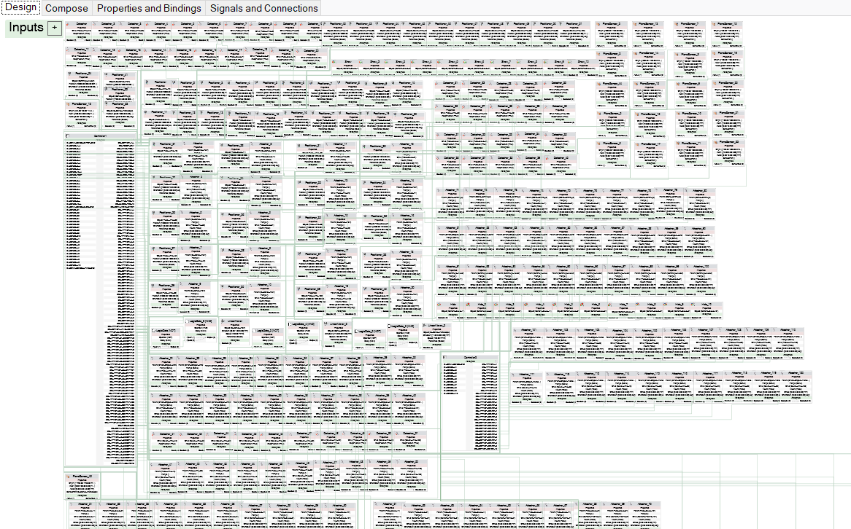

Conclusion and Future Work: Conclusion
What have we learned
New skills in Robot Studio
Teamwork
Solving complex task
© El Bestos Muchachos Teamos
2023 | Page 25/29
Conclusion and Future Work: Conclusion

Slide 26
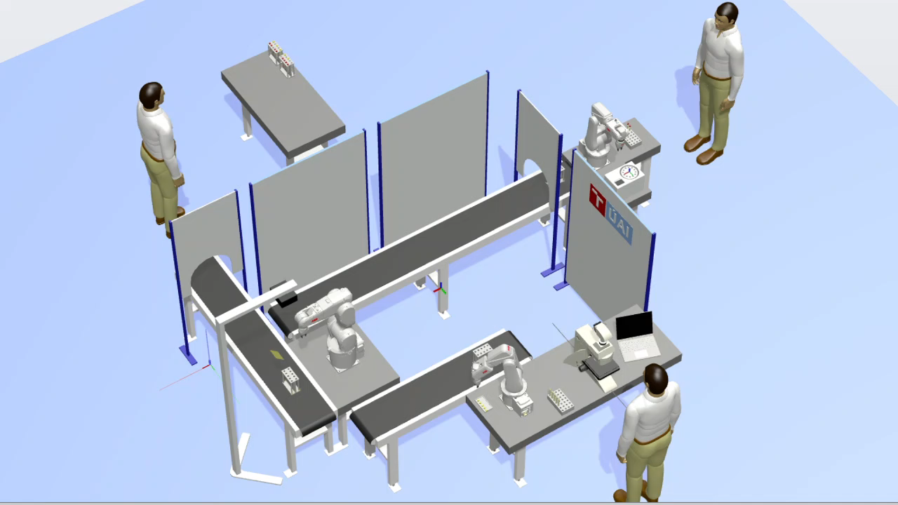
Conclusion and Future Work: Video
Video
© El Bestos Muchachos Teamos
2023 | Page 26/29
Conclusion and Future Work: Video

Slide 27
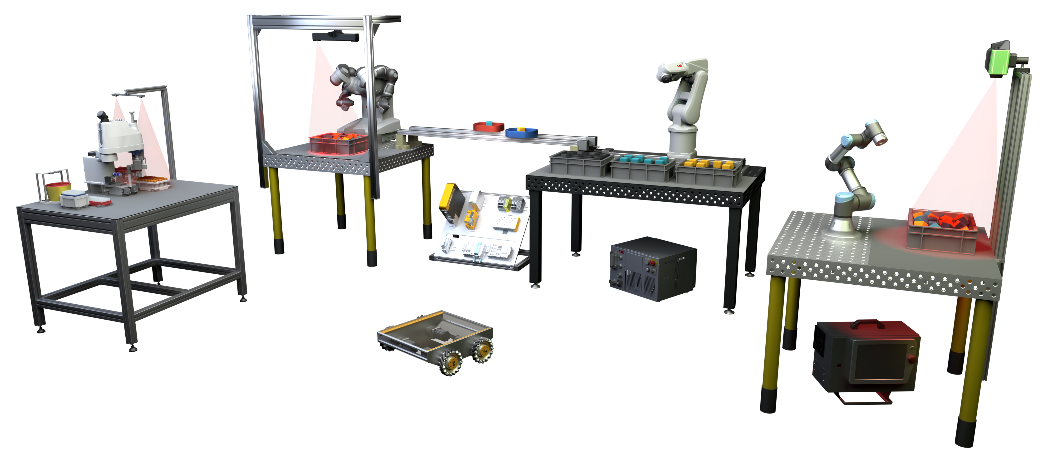
Thank You!

Slide 28
Questions?

Slide 29
INDUSTRY 4.0 CELL
INSTITUTE OF AUTOMATION AND COMPUTER SCIENCE

